Slide 1
Lecture 5
Informed Search Strategies

Slide 2
Heuristics
Heuristic means “rule of thumb”.
Judea Pearl
“Heuristics are criteria, methods or principles for deciding which among several alternative courses of action promises to be the most effective in order to achieve some goal”.
Heuristics are used to identify the most promising(showing signs of future success) search path.

Slide 3
Example of Heuristic Function
A heuristic function at a node n is an estimate of the optimum cost from the current node to a goal.
It is denoted by h(n).
h(n) = estimated cost of the cheapest path from node n to a goal node

Slide 4
Recall
• g(n) = cost from the initial state to the current state n.
• h(n) = estimated cost of the cheapest path from node n to a goal node.
• f(n) = evaluation function to select a node for expansion (usually the lowest cost node)

Slide 5
Example of Heuristic Function
Example 1:
We want a path from Islamabad to Lahore
Heuristic for Lahore may be straight-line distance between Islamabad and Lahore
h(Islamabad) = euclideanDistance(Islamabad, Lahore)

Slide 6
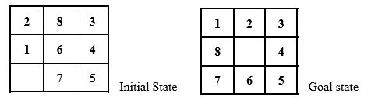
Example 2:
8-puzzle
Misplaced Tiles Heuristics is the number of tiles out of place.

Slide 7
Euclidean Distance Heuristic for 8-puzzle
The first picture shows the current state n, and the second picture the goal state.
h(n) = 5 because the tiles 2, 8, 1, 6 and 7 are out of place.

Slide 8
Manhattan Distance Heuristic for 8-puzzle
Manhattan Distance Heuristic:
Another heuristic for 8-puzzle is the Manhattan distance heuristic.
This heuristic sums the distance that the tiles are out of place.
The distance of a tile is measured by the sum of the differences in the x-positions and the y-positions.
Using the Manhattan distance heuristic, h(n) = 1 + 1 + 0 + 0 + 0 + 1 + 1 + 2 = 6
1 | 2 | 3
8 |  | 4
7 | 6 | 5

Slide 9
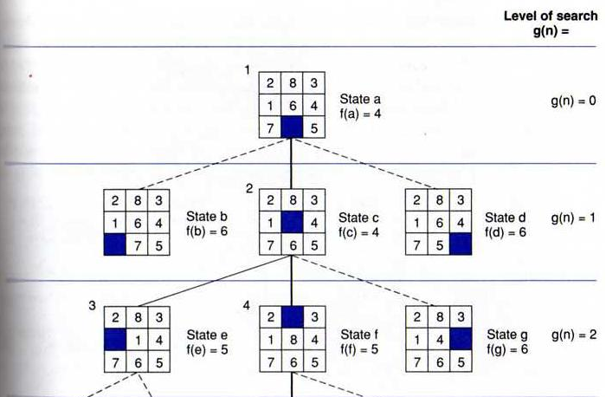
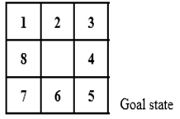
State space generated in Manhattan Distance heuristic search of the 8-puzzle

Slide 10
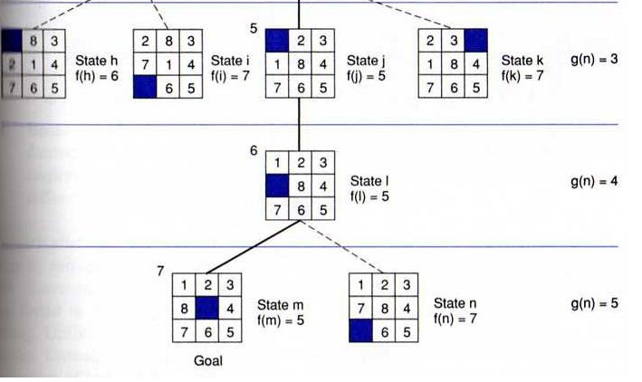
State space generated in heuristic search of the 8-puzzle

Slide 11
Best First Search
The algorithm maintains a priority queue of nodes to be explored.
A cost function f(n) is applied to each node.
The nodes are put in OPEN in the order of their f values.
Nodes with smaller f(n) values are expanded earlier

Slide 12
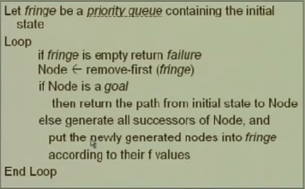
Best First Search

Slide 13
Greedy Best First Search
Idea:
Expand the node with the smallest estimated cost to reach the goal.
Use a heuristic function f(n) = h(n)
h(n) estimates the distance remaining to a goal.
Not optimal.
Incomplete

Slide 14
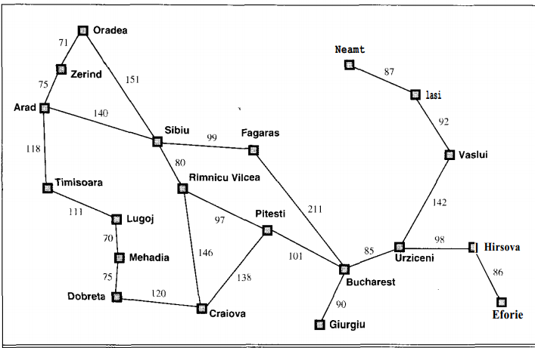
Map of Romania with road distances in km

Slide 15
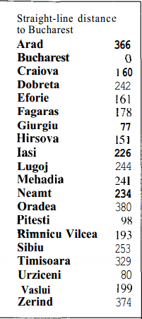
straight-line distances to Bucharest.

Slide 16
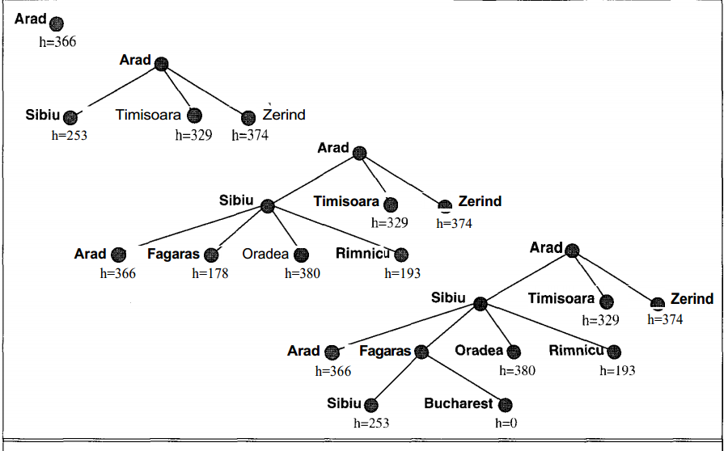
Stages in a greedy search for Bucharest, using the straight-line distance to Bucharest

Slide 17
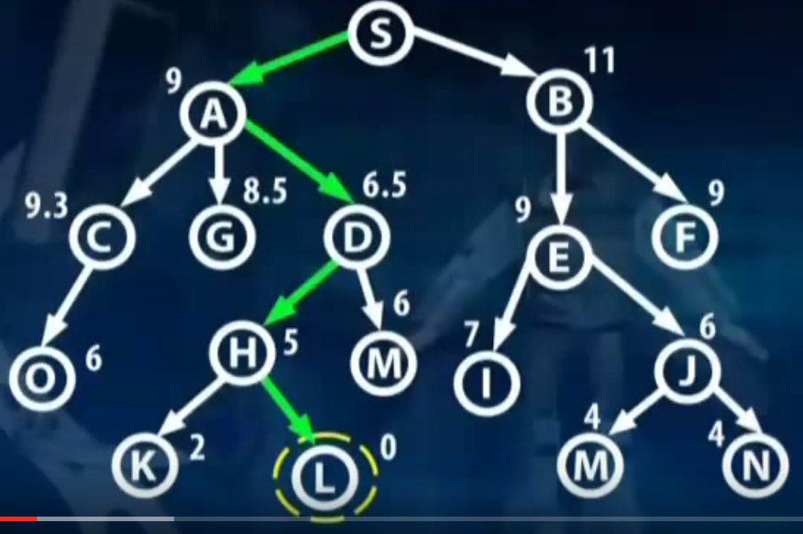
Best First Search (All options open)

Slide 18
Properties of Greedy Best First Search
Greedy search resembles depth-first search in the way it prefers to follow a single path all the way to the goal, but will back up when it hits a dead end.
It suffers from the same defects as depth-first search
It is not optimal.
It is incomplete because it can start down an infinite path and never return to try other possibilities.

Slide 19
Properties of Greedy Best First Search
Time & Space complexity:
The worst-case time complexity for greedy search is O(bm), where m is the maximum depth of the search space.
Because greedy search retains all nodes in memory, its space complexity is the same as its time complexity.
With a good heuristic function, the space and time complexity can be reduced substantially. The amount of the reduction depends on the particular problem and quality of the h function

Slide 20
Hill climbing
Maximize “value” of current state, by replacing it by successor state that has highest value, as long as possible.
Use heuristic to move only to states that are better than the current state.
The process ends when all operators have been applied and none of the resulting states are better than the current state.
No search tree is maintained, only the current state.

Slide 21
Hill climbing: Algorithm
Algorithm:
1. determine successors of current state
2. choose successor of maximum goodness
3. if goodness of best successor is less than current state's goodness, stop
4. otherwise make best successor the current state and go to step 1

